Slide 1
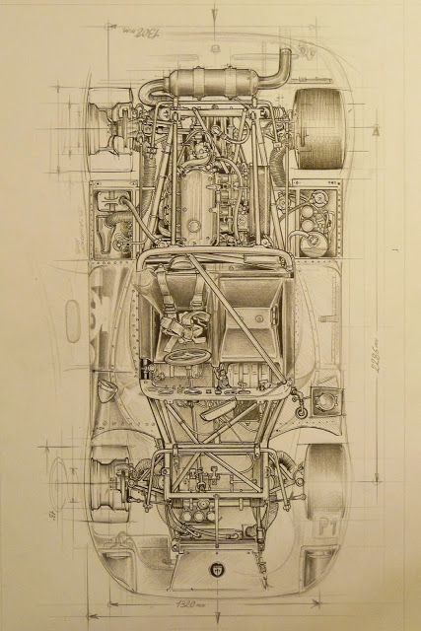
Engineering Projects PORTFOLIO
Rohit Venkataraman Iyer
MS, Mechanical Engineering
Email: riyer9@asu.edu
LinkedIn: www.linkedin.com/in/rohit-iyer-001

Slide 2
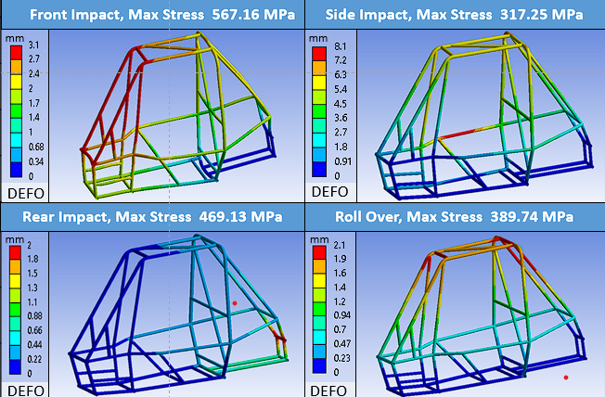
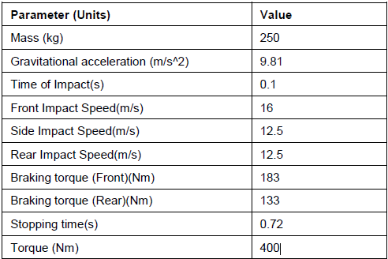
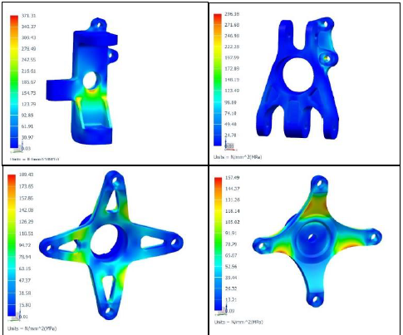
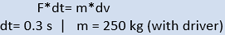
BAJA SAE – ATV design
Designed, manufactured and raced an All-Terrain Vehicle from 2017-2019.
Led the team as Vice Captain from 2019-19 and secured 1st position out of 450 teams in India in the Virtual Phase of the event.
Optimized designs by performing FEA analysis (Static structural, explicit, coupled thermal, modal, fatigue, Buckling) on all components using NX PLM and ANSYS.
The loading values were estimated using previous results and research articles.
Performed fatigue analysis to ensures a life of million cycles on heavily loaded components.
Performed coupled thermal and structural analysis on brake disks to create design resulting in max temperature of 170 C.
Improved design by reducing overall weight by 17 kg.
371 MPa
296 MPa
189 MPa
157 MPa

Slide 3
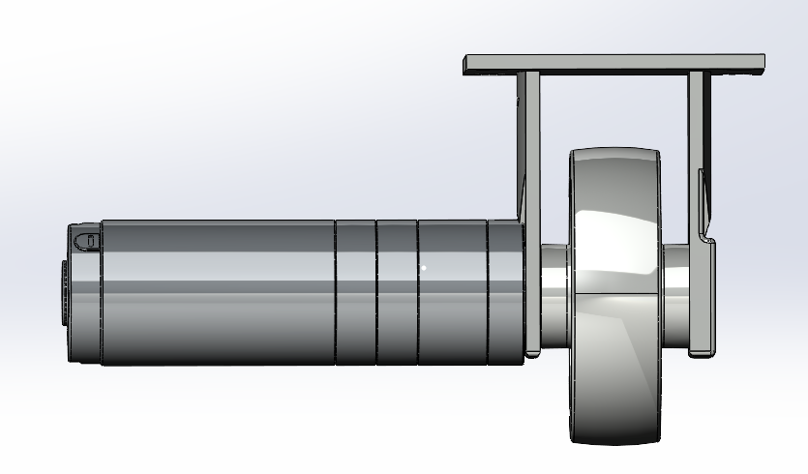
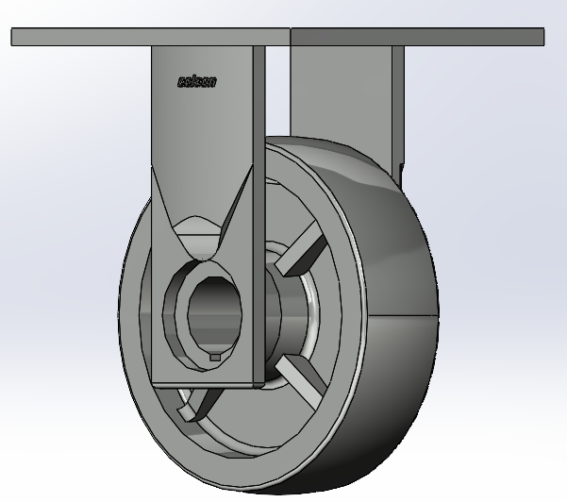
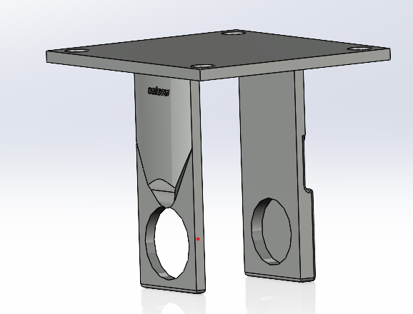
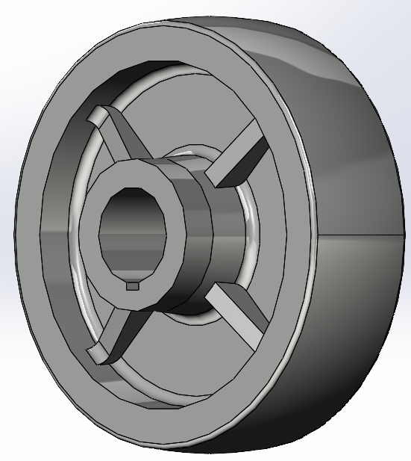
Design of motorized caster
OBJECTIVE: To design a motorized caster which retrofits into an existing medication cart and can push up to 250 lbs. of load in $800 to reduce strain on the hospital staff.
Modified design of their rigid casters to fit planetary motor which can transmit 10 Nm of torque capable of pushing 250 lbs.
Redesigned the rigid casters from “Colson Casters”, by changing the wheel hub and outer casing.
Designed brackets to hold the motor and battery in place using SolidWorks.
This caster will fit on the center of the bottom surface of an existing cart to motorize the cart.
Led the team by setting project guidelines, sourcing battery, motor and casters from different vendors, negotiated prices and created BOMs.

Slide 4
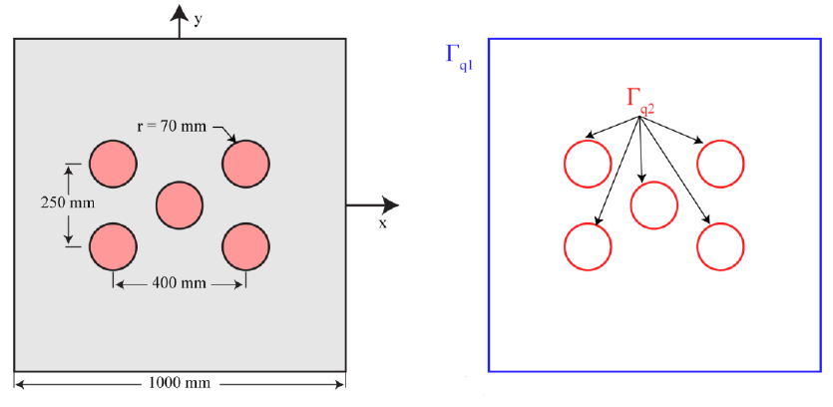
thermal Modelling of nuclear reactor using Abaqus and FEM
OBJECTIVE: To calculate heat flux and temperature generated in reactor due to heat from the five nuclear reactors using ABAQUS and validate using FEM code in MATLAB.
Modeled reactor as a 2D planar geometry with a heat source load applied to the rods and convection to the outer walls.
Experimented with different mesh element types (Tri3, Tri6 and Quad).
The temperature from Abaqus of 1679 K agreed with the MATLAB value on the right of 1672.7 K.
Abaqus values were overall in agreement with MATLAB and more accurate for large mesh sizes as the mesh quality dropped in smaller sizes.
Tri3>Tri6>Quad in terms of mesh quality and results and Tri6 got results faster than Tri3 as anticipated.

Slide 5
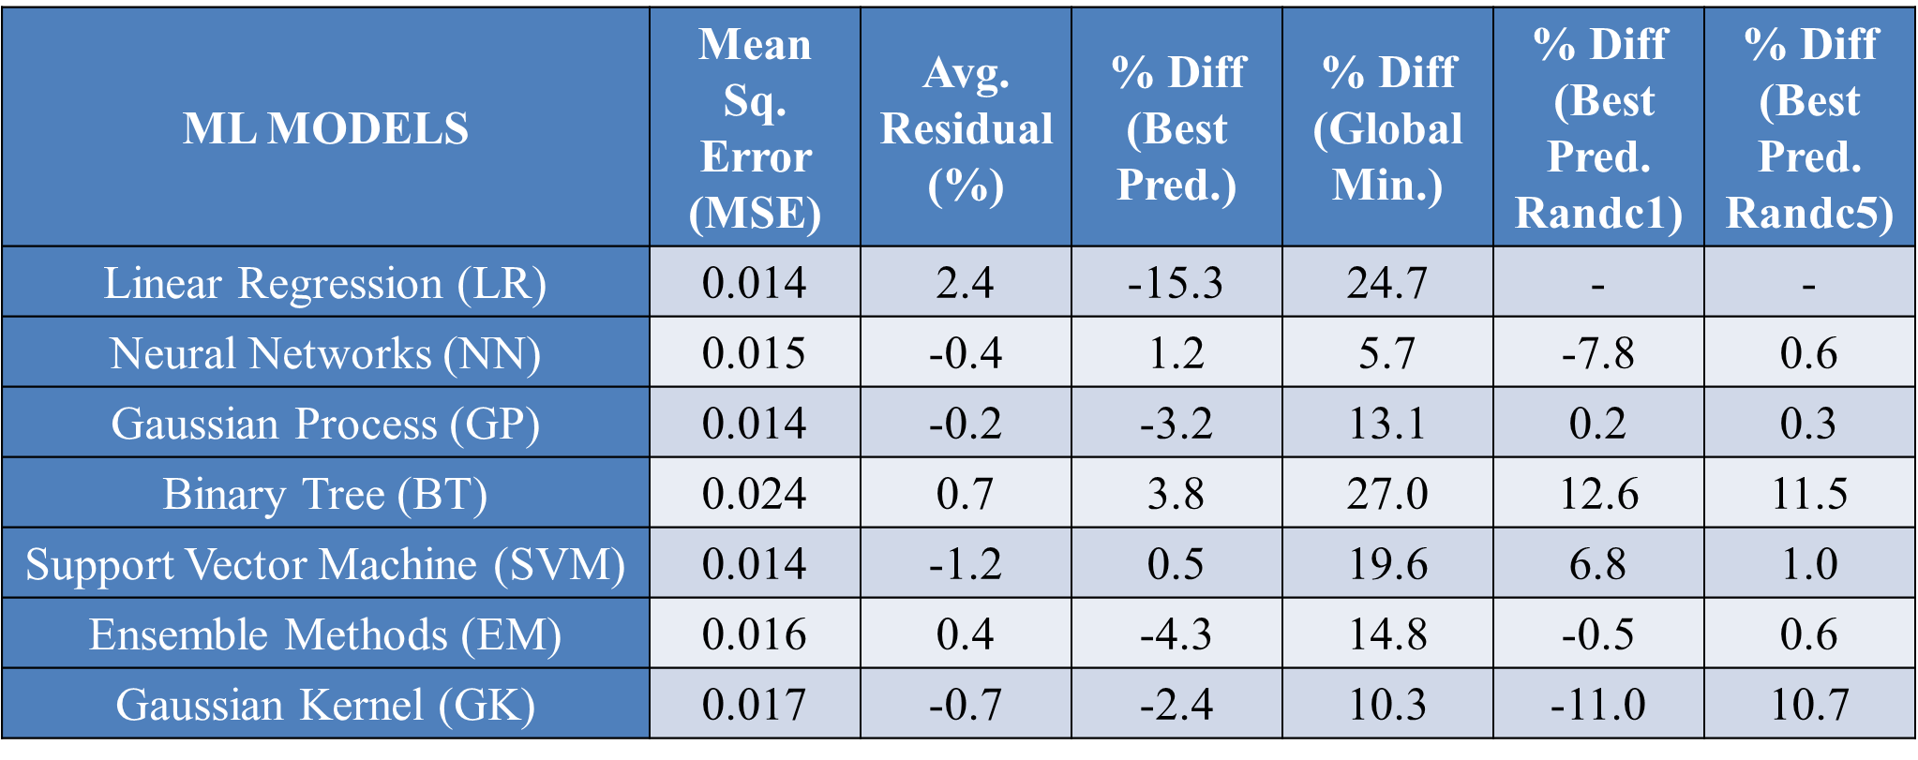
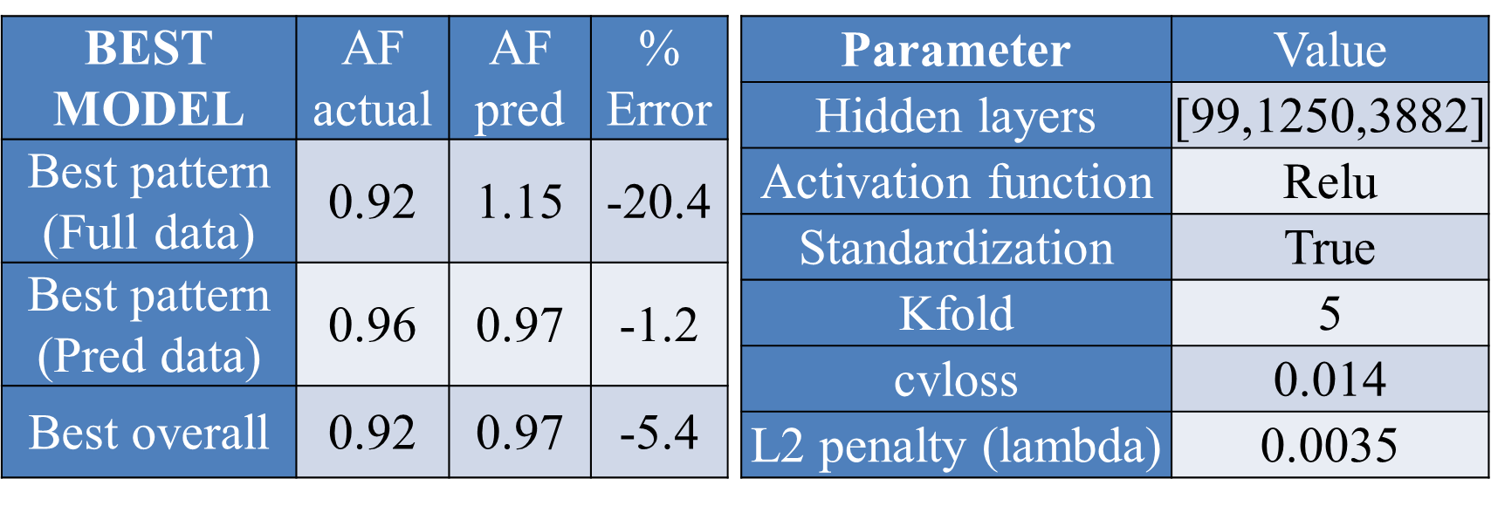
Optimization of Intentional Mistuning of Blisks Using ML
OBJECTIVE: Use ML regression algorithms to address the combinatorial explosion of intentional mistuning patterns with increase in N.
Utilized 20% of mistuning patterns to train and predict AF of the remaining patterns.
Choose appropriate ML models and tune the hyperparameters to achieve best prediction.
A fractional factorial study was carried out to find the best set of hyperparameters for both NN and GP and random mistuning was added to try and improve results.
The NN model identifies a few local minimum values of AF which are close to the global optimum.
The best model predicts a local optimum within 5% of the global optimum using fraction of the data (~20%).
It was observed that ordering the neurons in the hidden layers from small to large with three hidden layers the best results.

Slide 6
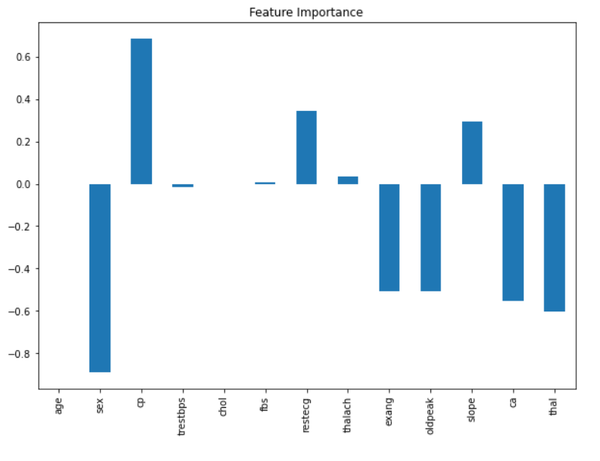
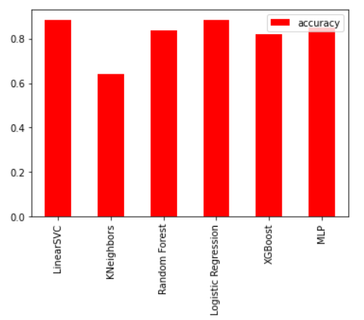
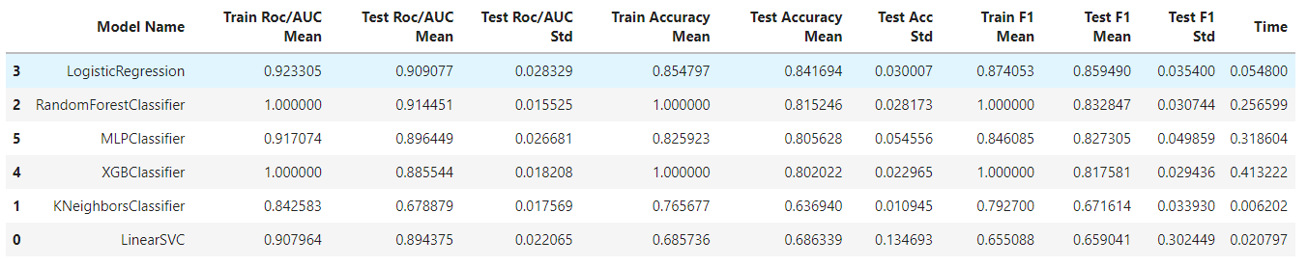
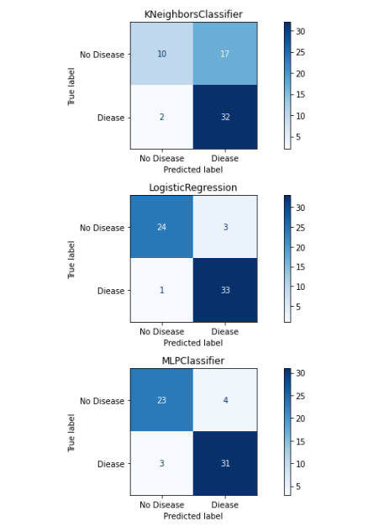
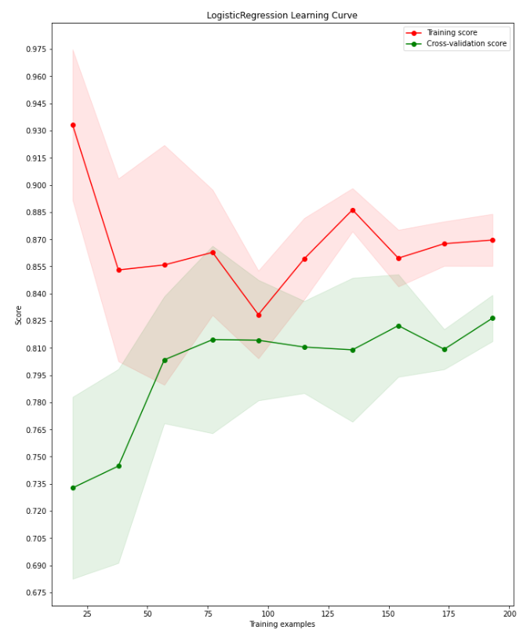
Prediction modelling of heart disease
OBJECTIVE: To predict heart disease in patients from the Cleveland database with 14 attributes using different ML classifiers which include: Linear SVC, K Neighbors, Random Forest, Logistic Regression, XGBoost and MLP.
Predicted outcome before tuning to set a baseline as shown.
Performed 5-fold cross validation to improve accuracy and noticed improvement in Logistic regression, Random Forest and XGBoost.
We have achieved a prediction accuracy of about 90% for Logistic regression, Random forest and XGBoost.
XGBoost (Extreme Gradient Boosting) model was used as it is a better model generally for classification, regression and ranking problems.
Although speaking in terms of medical standards, it might not seem that good, but our model does predict a heart disease correctly 9 out 10 times

Slide 7
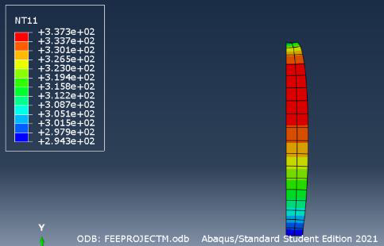
Coupled thermal analysis of pipe
OBJECTIVE: To calculate thermal stress and temperature in a pipe using FEM code and Abaqus and validating the result by analytical method.
Wrote FEM code to model temperature change in a fixed pipe with heat flux on both ends and used results to compute thermal stress using MATLAB.
Modelled the same problem in Abaqus as a 2D axisymmetric problem using a quad mesh with linear element type.
The mesh study is performed to ensure convergence of values as mentioned.
From the graphs we can conclude that the values of temperature, displacement and stress are similar in all three methods validating our results.
There are minor differences in results due to the FEM code being based on weak form, Analytical model on strong form and Abaqus model being 2D in nature.
Max Disp: 2.29e-6 m
Max Temp: 337 K
Max Stress: 80.2 MPa

Slide 8
Optimization of design of pmma plate
OBJECTIVE: To design PMMA (Plexiglas) plate to withstand maximum force before failure and validate design by destructive testing.
The plate was modelled and analyzed in ANSYS using 2D plane stress condition and symmetry to reduce it one fourth to reduce computation time.
F/2 is applied at the top and the symmetry act as frictionless boundary conditions thus accurately modelling the loading.
The mesh was mostly quad elements with controls to ensure the mesh is fine near the slot region.
Parametric optimization was conducted to improve the design to maximize the breaking load.
We get a stress of 58 MPa post 0.1% mesh convergence study at a load of 1300 N which within +/- 0.05% of value captured from DIC.

Slide 9
Design optimization of brake disk
Stress: 14 MPa
Freq: 2079.8 Hz
Temp: 311.6 C
OBJECTIVE: To optimize design of break disk while maintaining its structural, modal and thermal integrity. The design variables are its ID, OD and thickness. The goal is to have low strain and temperature and high frequency values.
The disk is rotating at 250 rad/s and a pressure of 10.5 MPa is applied as breaking force to calculate Von Mises stress and volume.
Modal analysis is conducted to find the natural frequency. 7th frequencyy is selected as our output.
Transient thermal analysis is conducted with a heat flux of 1500 kW/m² to outer surface of disk.
10 design points are generated using the Latin Hypercube Sampling method and Five verification points are used to estimate the accuracy of the response surface.
Sensitivity analysis shows thickness has highest positive effect and largest effect on temperature. Thus, we must increase ID and reduce OD and t.
Optimization using MOGA (Multi Objective Genetic Algorithm), gives us ID: 78 mm, OD: 134 mm and t: 22 mm.

Slide 10
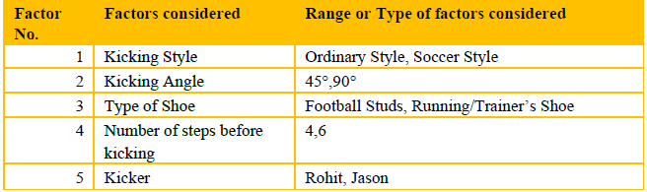
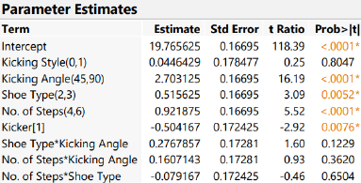
OPTIMIZATION OF DISTANCE COVERED BY A FOOTBALL USING DESIGN OF EXPERIMENTS (DOE)
OBJECTIVE: To optimize distance of football kicked based on five parameters by understanding their effects on our response variable.
Constant factors include ground conditions while uncontrollable factors are wind, weather (humidity, temperature etc.).
2K design is chosen with randomized run order generated using JMP and the results are shown in the tables.
JMP was used to analyze the design with blocking (kicker) to obtain the actual vs predicted plot and ANOVA and later without it to find the interaction effects.
Kicking style and interaction effects were removed and reduced JMP model was analyzed, and ANOVA was performed.
Kicking angle, number of steps, and shoe type are important and in that order.
The small PRESS value indicates that the model is good.
The very high value of power for the important factors is a good indicator.
For best results, the ball must be kicked at 90-degrees, with 6 steps back and in football shoes.

